Slide 1
Big Mountain Resort - Consulting Proposal, Findings, & Report
October 19, 2020

Slide 2
Problem Identification:
Before Nov 15, 2020 Big Mountain Resort needs to offset $1.6M in operating cost by restructuring their pricing model for tickets to reflect the value of the facilities they provide.
This in turn will lead to a more cohesive understanding of what each facility is worth to our customers and better guide our investment strategy.

Slide 3
Criteria for Success:
Develop a pricing model that will negate the $1.6M in additional operational cost for this year.
It must accurately reflect which facilities customers value and are willing to pay for.
Appropriately adjust funding for respective facilities, adjust ticket price for the value that the facilities provide to the customers.
This will be done by studying the relationship between the facilities other resorts provide and what they price their tickets at.

Slide 4
Key Findings:
Big Mountain Resorts current adult weekend price: $81
Models predicted price: $89.8
Scenario 2 equates to an annual revenue increase of ~$3.5M.
Ticket price raised by $1.99 ($82.99)
Closing the 10 most unpopular runs = yearly loss of ~$3.0M, or -$1.75/ticket.
Closing 1 run would have no change in ticket price
There is no change between closing 3, 4 or 5 runs; all of which result in ~$1.2M loss of yearly revenue.

Slide 5
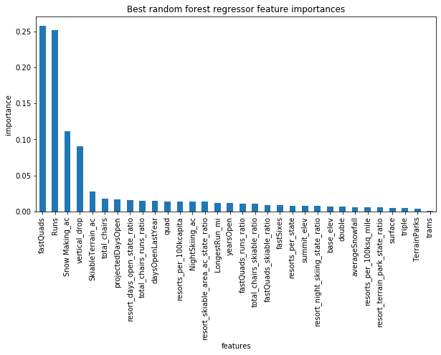
Modeling & Analysis:
Top four facilities/features that directly correlated with ticket price:
Fast quads
Number of runs
Snow making acerage
Vertical drop

Slide 6
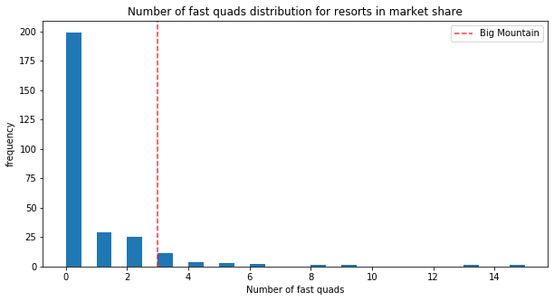
Modeling & Analysis:
Why do fast quads drive price the most?
The amount of lifts a resort has directly impacts how quickly the resort can get people up the mountain and back on a run.
Fast sixes and fast eights don’t have nearly as much impact yet because there are not enough resorts with these lifts in place to determine how they affect ticket price.

Slide 7
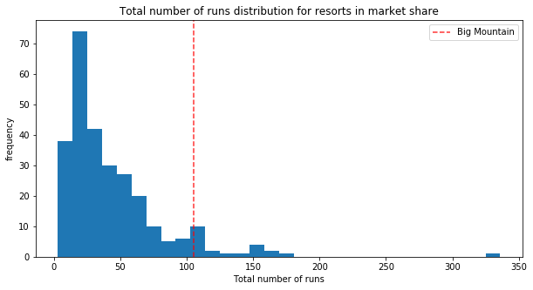
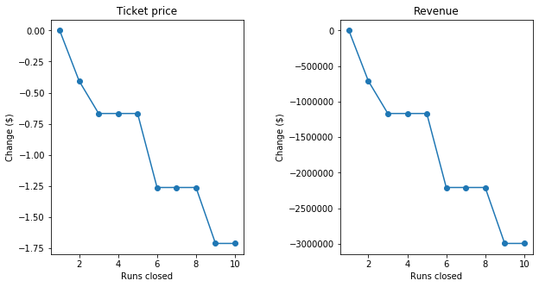
Modeling & Analysis:
Scenarios considering the amount of runs to close
Big Mountain Resort is currently among some of the resorts with the most amount of runs in the nation.
Closing runs would have a substantial amount of impact on ticket price for the resort.

Slide 8
Summary and Conclusion:
I suggest that Big Mountain Resort weigh the cost of closing runs against the benefit of adding other facilities and features to negate the annual loss of revenue.
In addition, the amount of money saved by closing runs should be calculated and incorporated into the data to better understand how closing a run may or may not benefit the ticket price.
I recommend following Scenario 2, as it clearly offsets the cost of installing a new chair lift (~$1.6M) twice over.

